Slide 1
CSCI2100D Lab 1
Xinyu Du
Department of Systems Engineering and Engineering Management
Chinese University of Hong Kong

Slide 2
Welcome to CSCI2100D Lab!
Tutorial slides will be uploaded to Blackboard 1 day before each tutorial.
Piazza for discussion and questions
4 individual programming labs (3% each + bonus)

Slide 3
Outline
Online Judge Platform
Recommended IDEs
C language
Overview of Lab 1 Problems

Slide 4
Outline
Online Judge Platform
Recommended IDEs
C language
Overview of Lab 1 Problems

Slide 5
Online Judge Platform
Online Judge Platform (OJ)
Website: https://oj.boleyn.su/
All 4 labs will be delivered via the OJ
Problems and their description
Submission of your codes
Judgement of correctness
You will get full mark on the problem if your code passes all testcases (accepted);
Your code only need to be accepted once, 1 accepted after 10 error is still full mark.
Extra practice questions are available apart from those in the 4 labs.

Slide 6
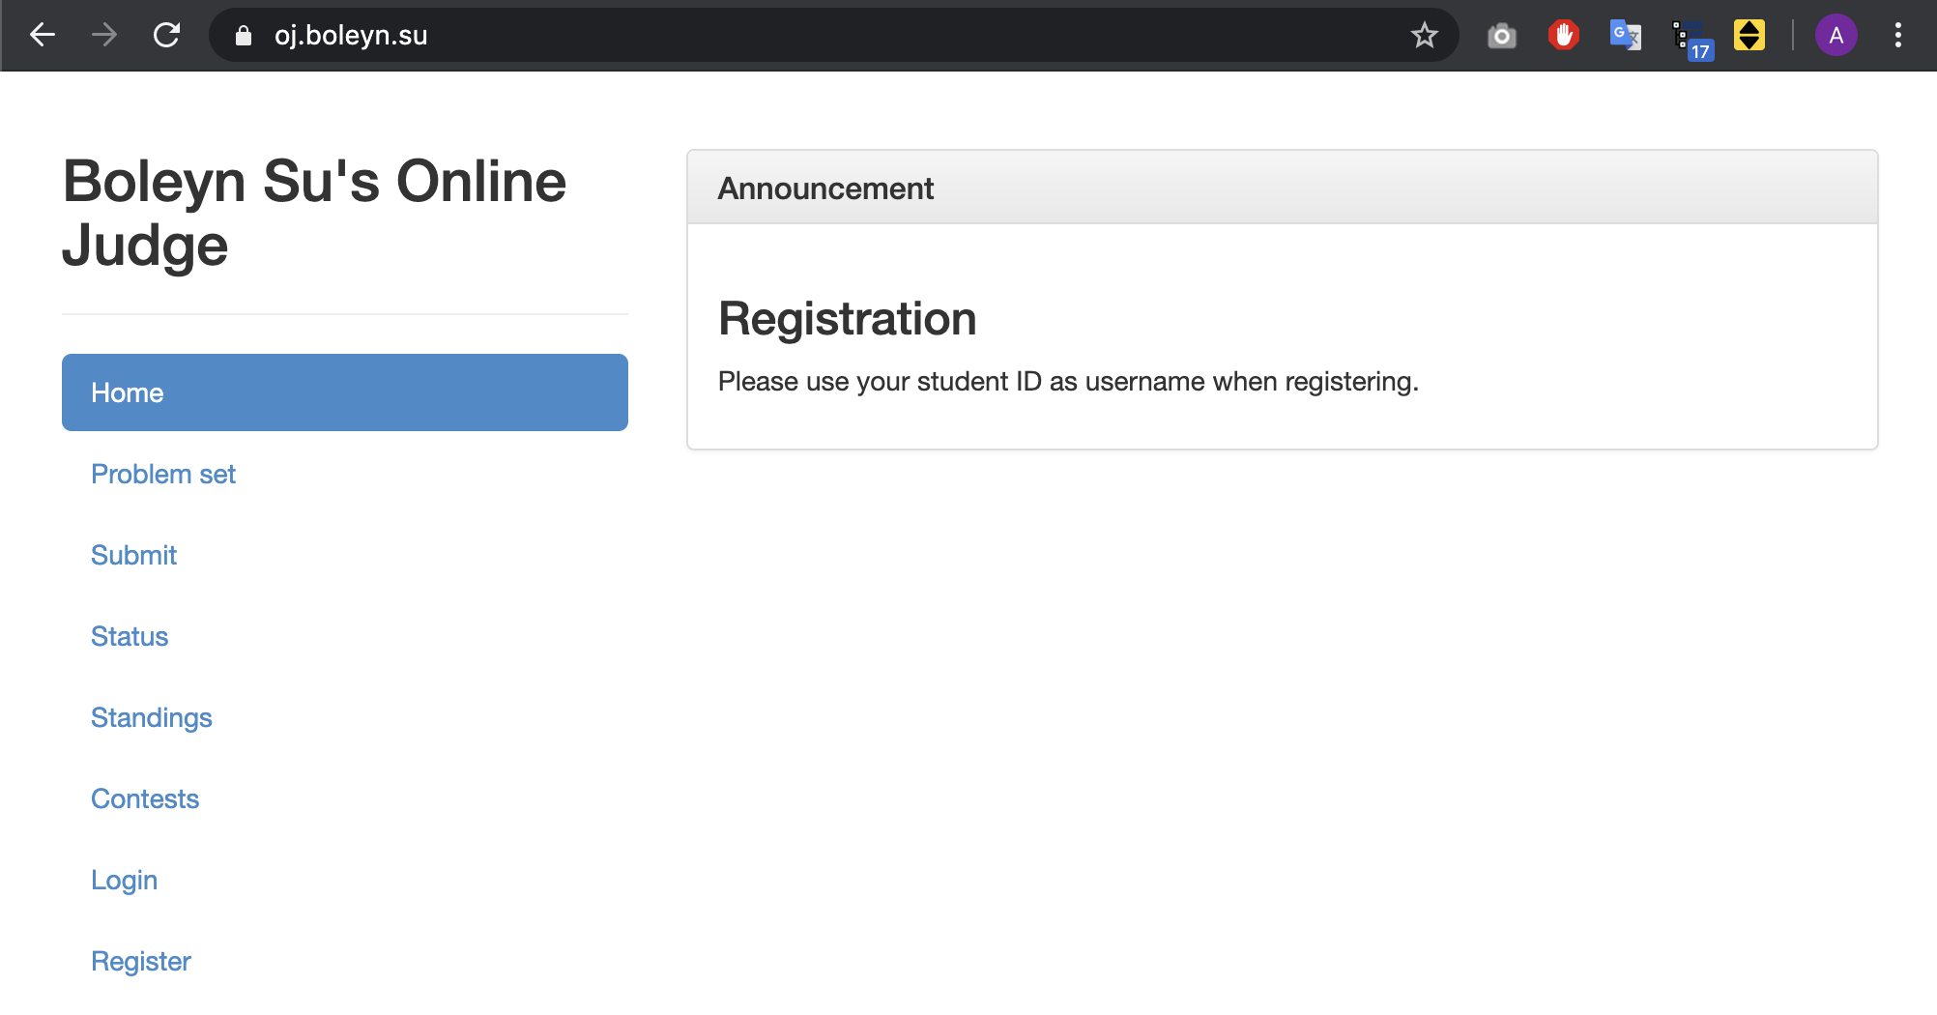
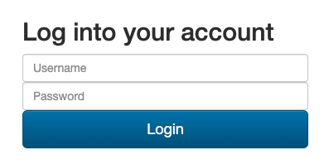
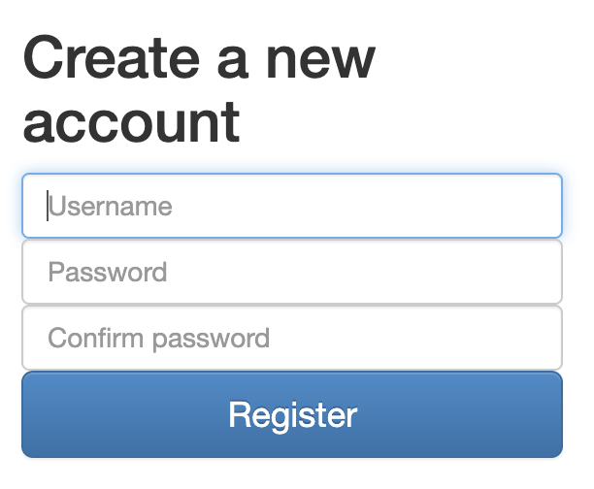

Online Judge Platform
Guidelines on OJ
Registration
Click Register → Register (your sid as username) → Click Login → Login
Please make sure you register correctly with your sid as grading of your score relies on your sid.

Slide 7
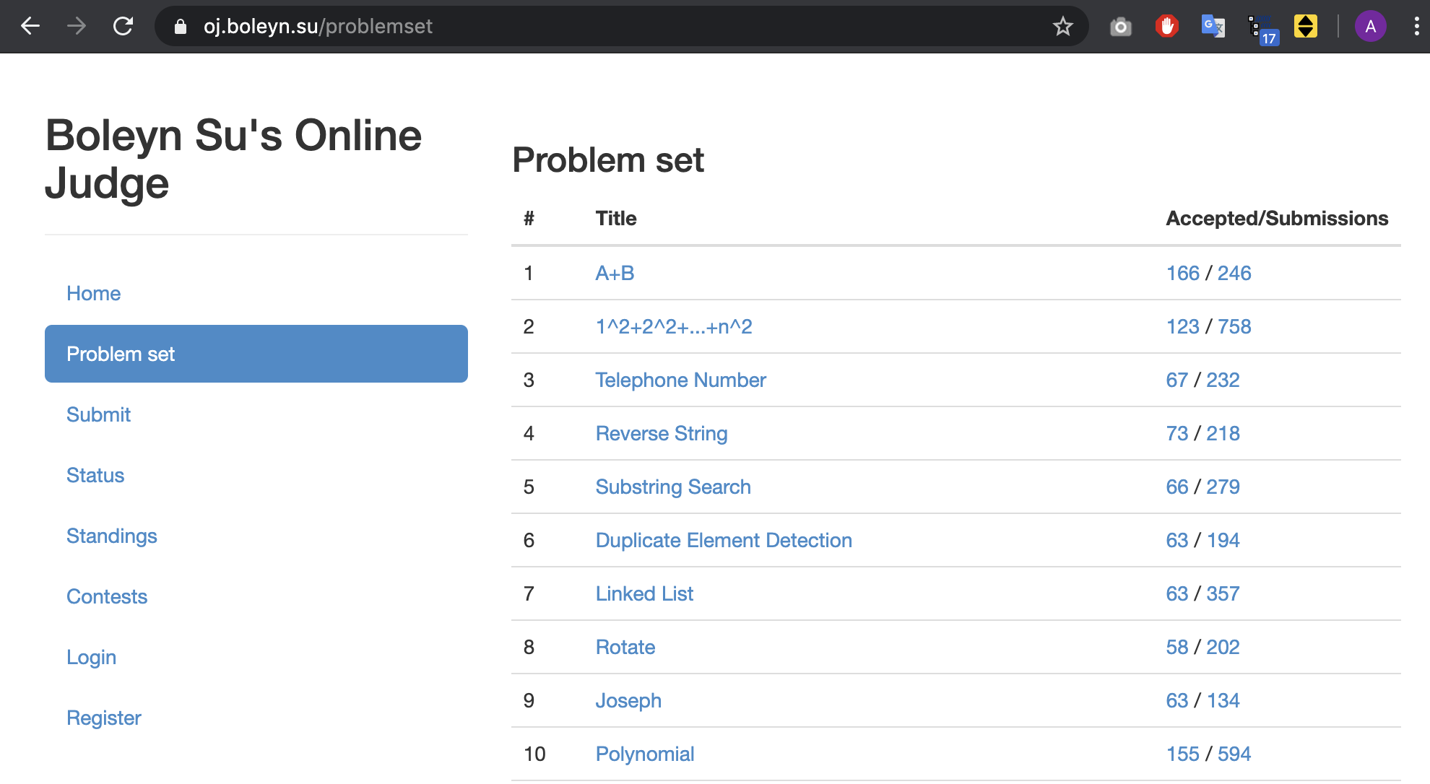
Online Judge Platform
Guidelines on OJ
Problem Set
List of problems you can try to solve.
E.g., A+B

Slide 8
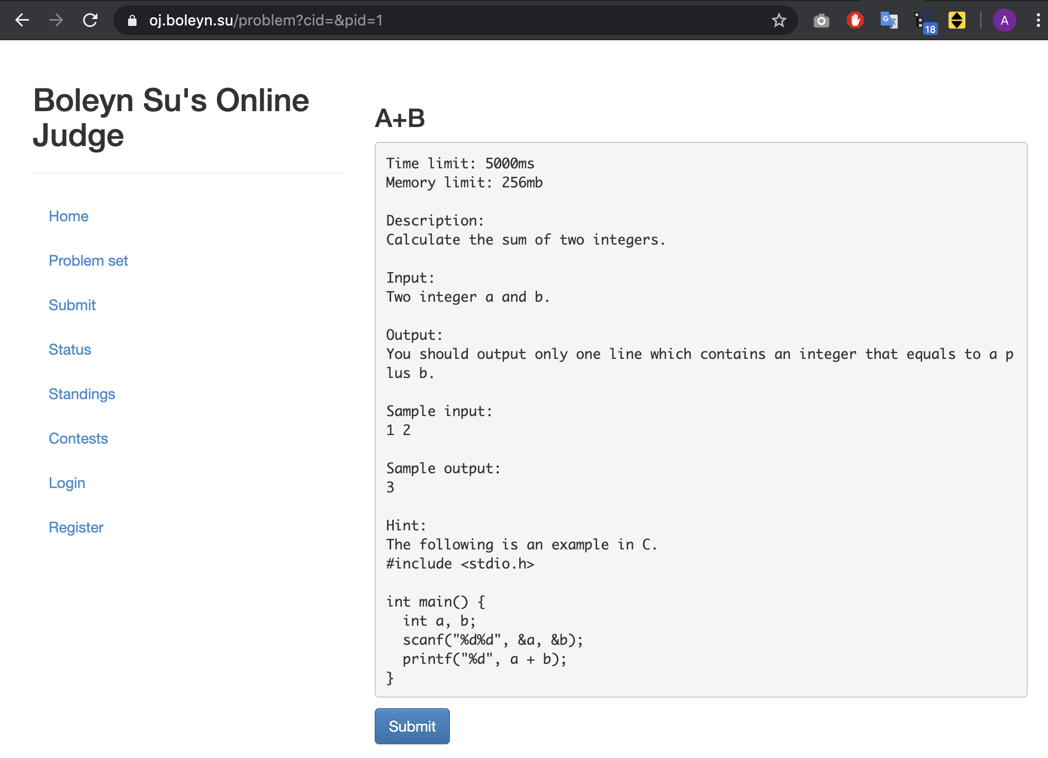
Online Judge Platform
Guidelines on OJ
Problem Description
Description, input/output specifications (samples) of the problem are provided
Copy the demo code
Click Submit
Demo Code

Slide 9
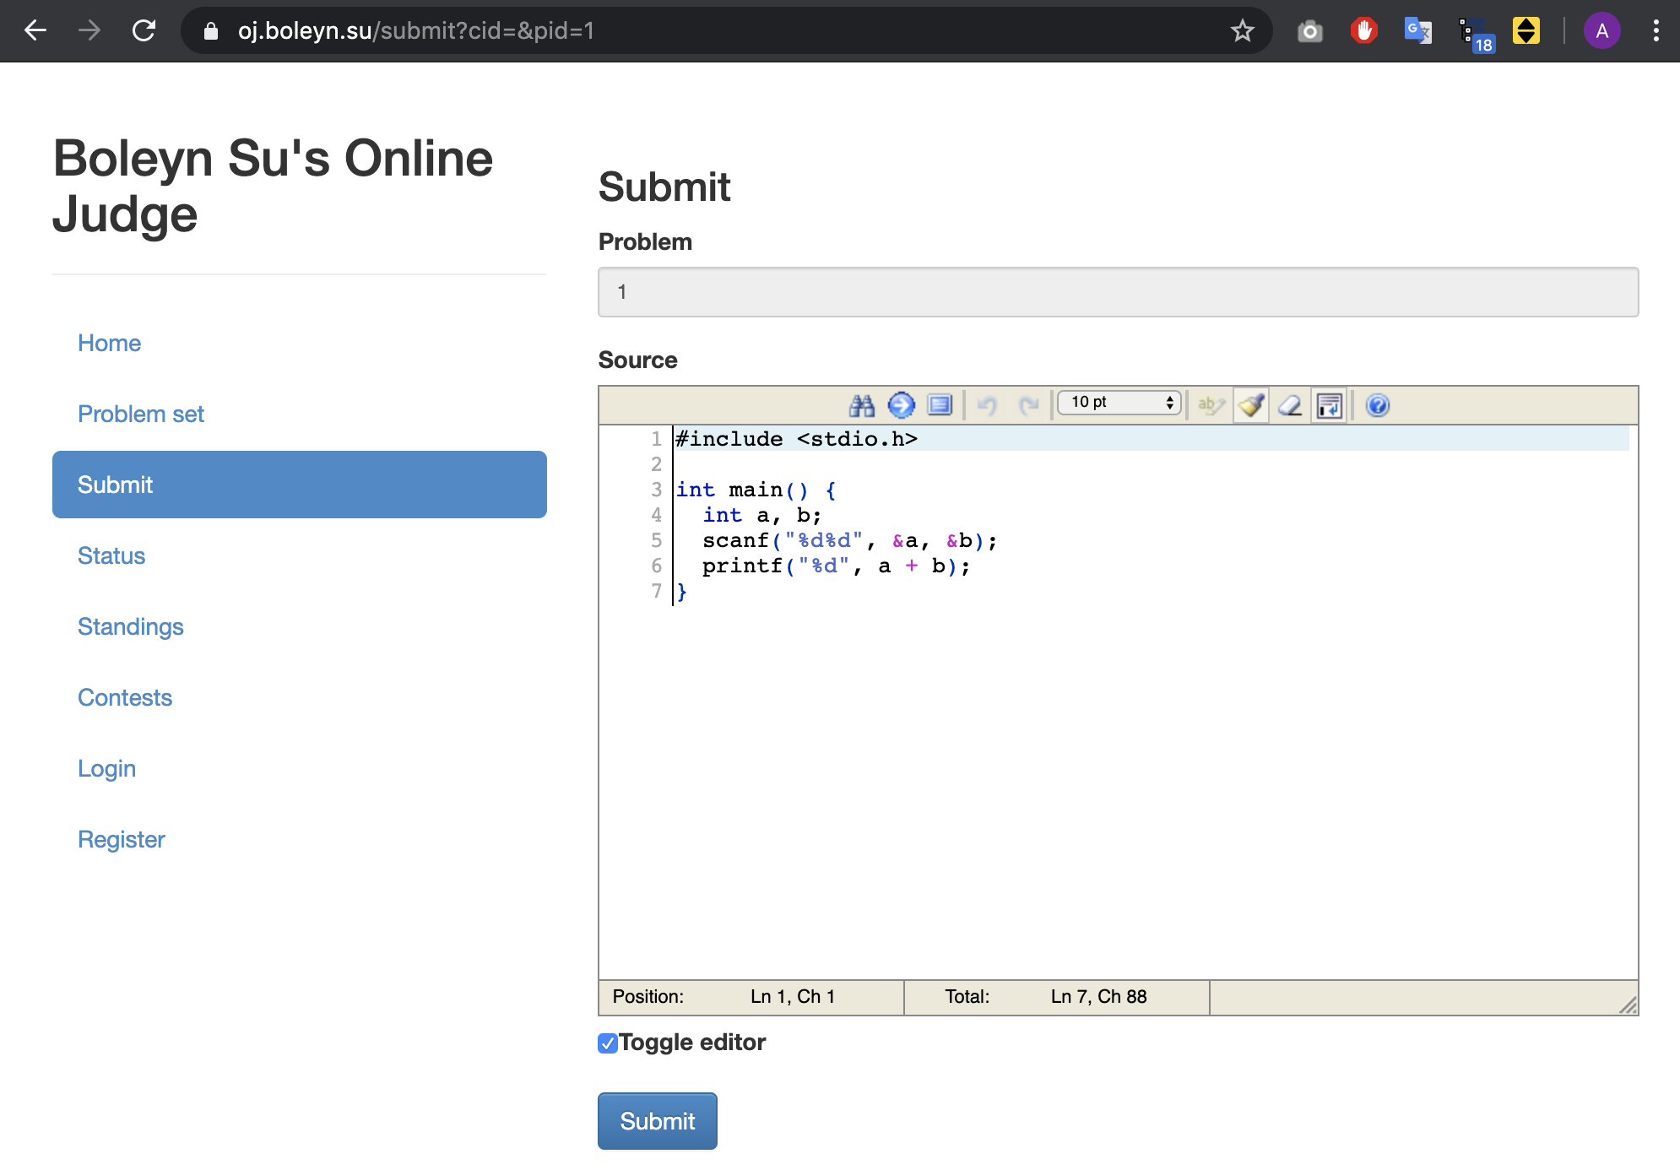
Online Judge Platform
Guidelines on OJ
Code Submission
Paste the demo code and click Submit
Demo Code

Slide 10
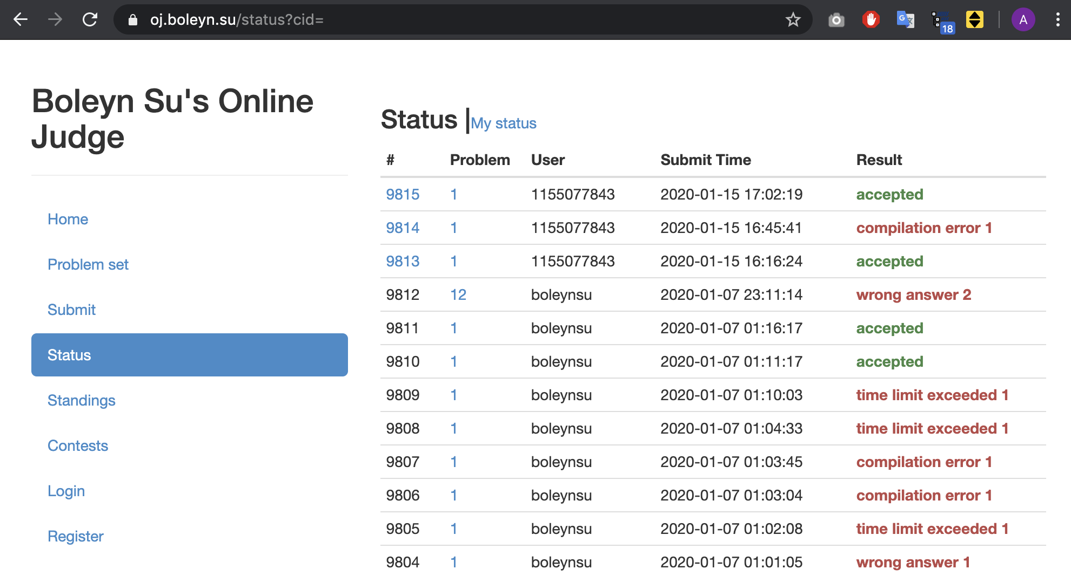
Online Judge Platform
Guidelines on OJ
Submission Status
accepted: compiled successfully with correct answers on all testcases and executed within time limit
error: wrong answer #n, time limit exceeded #n, compilation error

Slide 11
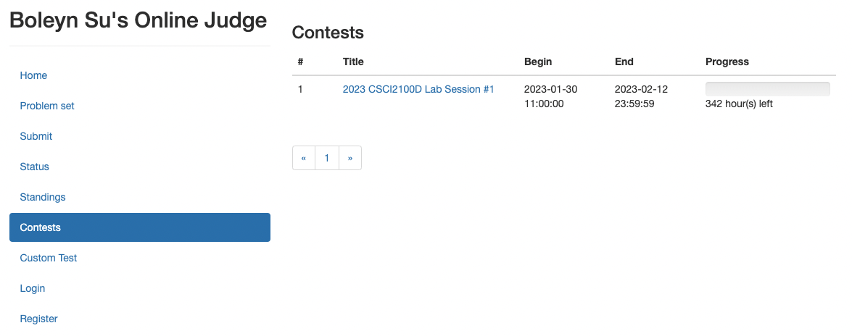
Online Judge Platform
Guidelines on OJ
Lab Assignments
Each lab assignment will appear at Contests upon release of it.
After the deadline specified by End, no more submission will be accepted.
Click into the title to submit your codes.

Slide 12
Outline
Online Judge Platform
Recommended IDEs
C language
Overview of Lab 1 Problems

Slide 13
Recommended IDEs
Several IDEs
Visual Studio Code (Windows/Mac)
https://code.visualstudio.com/
CodeBlock (Windows/Mac)
http://www.codeblocks.org/downloads/26
Dev C++ (Windows)
https://sourceforge.net/projects/orwelldevcpp/
Also Consider:
Online C IDE
Text editor + C compiler
Xcode
Others

Slide 14
Outline
Online Judge Platform
Recommended IDEs
C language
Overview of Lab 1 Problems

Slide 15
C language
Compilation Model
Most frequently used and free available compiler:
GNU C compiler
Installation:
https://www.tutorialspoint.com/cprogramming/c_environment_setup.htm
Compile in terminal under the directory with your C source code, e.g.:
source code
preprocessor
compiler
(additional code)Libraries
object code
(machine instructions)
linker
executable code
$ gcc hello.c –o hello_program
$ ./hello_program
Hello, World!

Slide 16
C language
All programming labs must be completed with C only (not C++).
Assume basic knowledge of C.
Syntax, data type, function, variable scoping, control flow, loop, pointer, array, struct, header file, …
Nice C tutorials:
https://www.learn-c.org/
https://www.tutorialspoint.com/cprogramming/index.htm
Google

Slide 17
C language
Revisit
Pointer
Output
#include <stdio.h>
int main () {
int var = 20; // actual variable declaration
int *ip; // pointer variable declaration
ip = &var; // store address of var in pointer variable
// address stored in pointer variable
printf("Address of var variable: %x\n", &var );
printf("Address stored in ip variable: %x\n", ip );
// access the value using the pointer
printf("Value of *ip variable: %d\n", *ip );
return 0;
}
Address of var variable : bffd8b3c
Address stored in ip variable: bffd8b3c
Value of *ip variable: 20

Slide 18
C language
Revisit
Struct
Output
#include <stdio.h>
#include <string.h>
struct Books {
char title[16];
int book_id;
};
void printBookTitle( struct Books *book ) {
printf( "Book title : %s\n", book->title);
}
int main( ) {
struct Books Book1; // Declare Book1 of type Book
strcpy( Book1.title, “C language");
// print Book1 info by passing address of Book1
printBook( &Book1 );
return 0;
}
Book title : C language

Slide 19
C language
Revisit
Header File
The C preprocessor scans the specified file as input before continuing with the rest of the current source file.
E.g.:
#include <file> // for system header files
#include "file” // For self-written header files
// test.h
char *test (void);
//test_demo.c
int x;
#include "test.h"
int main (void) {
puts (test ());
}
Output of C preprocessor while compiling test_demo.c
int x;
char *test (void);
int main (void) {
puts (test ());
}

Slide 20
C language
Revisit
Abstract Data Type (ADT)
Extending from the primitive data type in C, e.g. int, char, float, …
Idea of ADT
Implementation details are hidden
Able to use the ADT:
With the interface
Without knowing about the low-level logistics
An ADT may be implemented in different data structures
E.g., Stack may be implemented with linked list or array

Slide 21
Outline
Online Judge Platform
Recommended IDEs
C language
Overview of Lab 1 Problems

Slide 22
Declaration
3 Problems (Required) + 1 Problem (Bonus)
Please add this declaration on the top of (commented as shown) all your codes submitted to the OJ.
/*
I, <Your Full Name>, am submitting the assignment for
an individual project.
I declare that the assignment here submitted is original except for source material explicitly acknowledged, the piece of work, or a part of the piece of work has not been submitted for more than one purpose (i.e., to satisfy the requirements in two different courses) without declaration. I also acknowledge that I am aware of University policy and regulations on honesty in academic work, and of the disciplinary guidelines and procedures applicable to breaches of such policy and regulations, as contained in the University website http://www.cuhk.edu.hk/policy/academichonesty/.
It is also understood that assignments without a properly signed declaration by the student concerned will be graded as zero by the teacher(s).
*/

Slide 23
Problem 1
Circular Left Shift
Use the provided code template, complete the missing part.
Description:
Given an integer array A and an integer number k, please perform a circular left shift on the array by k steps.
Input:
The first line contains two integers: N and k (k can be 0);
The second line contains an array of N integers, a_0, a_1, ..., a_(N-1);
Output:
The shifted array.
Sample Input 1: The first shift: 2 3 4 1
4 3 The second shift: 3 4 1 2
1 2 3 4 The third shift: 4 1 2 3
Sample Output 1:
4 1 2 3
Sample Input 2: Sample output 2:
1 5 100
100

Slide 24
Problem 2
Set Union and Intersection
Familiarize with the usage of ADT.
Just apply the described function(s) and ignore the underlying implementation.
Choose the appropriate function(s) to apply.
The implemented ADT interface
struct Node {
int elem;
struct Node * next;
};
struct Set {
struct Node * nodes;
};
struct Set * init_set();
void free_set(struct Set *s);
void set_insert(struct Set * s, int x);
struct Set *calc_intersection(struct Set *a, struct Set *b);
struct Set *calc_union(struct Set *a, struct Set *b);
void print_set(struct Set *s);

Slide 25
Problem 2
Set Union and Intersection
Use the provided code template, complete the missing part.
Description:
Given four arrays of non-negative integers, denoted as arrA, arrB, arrC and arrD. Please use the implemented ADT to complete the missing part:
1. create the setA, setB, setC and setD from the arrays arrA, arrB, arrC and arrD;
2. calculate the union of setA and setB as setE;
3. calculate the intersection of setC and setD as setF.
4. calculate the union of setE and setF, and print it out.
Input:
First line is two integers A, B, C and D;
Second line is arrA of A non-negative integers;
Third line is arrB of B non-negative integers;
Fourth line is arrC of C non-negative integers;
Fifth line is arrD of D non-negative integers;
Output:
The union of setE and setF(as in the description).
Sample Input 1: Sample Output 1:
2 3 3 4 2 3 5 6 7 8
5 6
7 5 8
1 2 3
2 3 6 8

Slide 26
Problem 3
Find Valley Element
Use the provided code template, complete the missing part.
Hint: use the binary search.
Description:
A valley element is an element that is strictly less than its neighbors.
Given a 0-indexed integer array nums, find a valley element, and return its index. If the array contains multiple valleys, return the index to any of the valleys.
You may imagine that nums[-1] = nums[n] = +∞. In other words, an element is always considered to be strictly less than a neighbor that is outside the array.
Hint: You must write an algorithm that runs in O(log n) time.
Input:
First line is an integers N;
Second line is the array of N integers;
Output:
The output has one line. The number is the index of the valley element.
Sample Input 1: Sample Output 1:
4 2
9 5 3 8

Slide 27
Problem 4 (Bonus)
Subarray Product Between L and R(bonus)
Additional 0.5 points.
Description:
Given an array of integers nums and two integer L and R, return the number of contiguous subarrays where the product of all the elements in the subarray is strictly between L and R.
You need to design an efficient algorithm with a O(n) time complexity. Otherwise, you may exceed the time limit.
Input:
First line consists of three integers N, L and R;
Second line is an array A of N positive integers;
Output:
The number of subarrays with product between L and R.
If there exist no subarray with sum at least K, return 0.
Sample Input 1: Sample output 2:
4 10 100 3
10 5 2 6

